Slide 1

A Real-Time Barcode-Enabled Inventory Tracking System
Theme- SDG 9 – Industry, Innovation and Infrastructure
Category- Software
Group No - 6
Group Members- Aakshat Mukkawar, Rohit Nahar, Tejas Vinay Maske, Atharva Mayekar
Guide- Viki Patil Sir

Slide 2
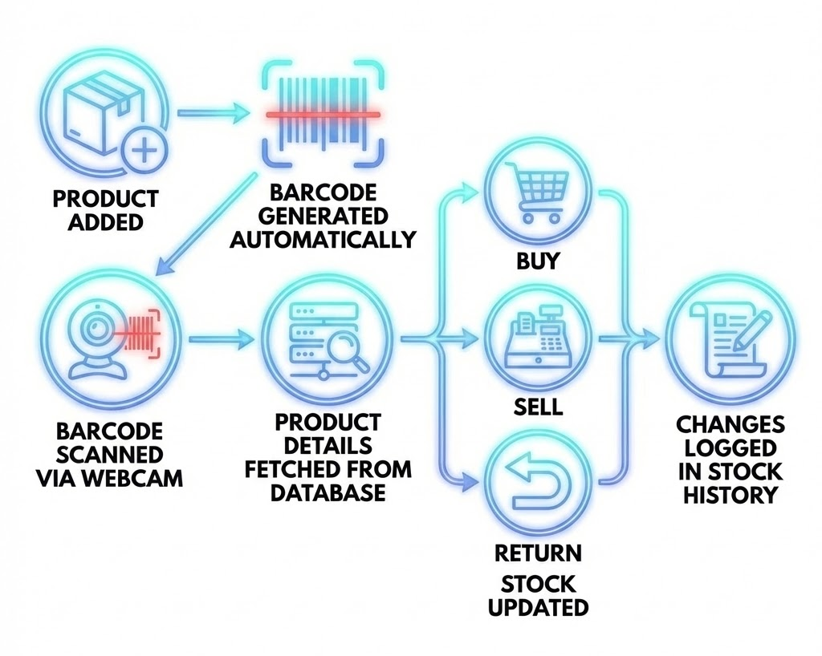
Proposed Solution
Overview
A web-based inventory management system for small retail shops
Replaces manual stock registers with a digital, barcode-driven system
Designed to be lightweight, affordable, and easy to deploy
Data Management & Context
Centralized database stores product, category, and stock information
Each product is mapped to a unique SKU and barcode
Additional context stored:
Category
Shelf number (physical location)
Reorder level for low-stock alerts
Identification & Stock Operations
Barcode generated automatically for each product
Camera-based barcode scanning using OpenCV
All stock changes logged with timestamps for traceability

Slide 3
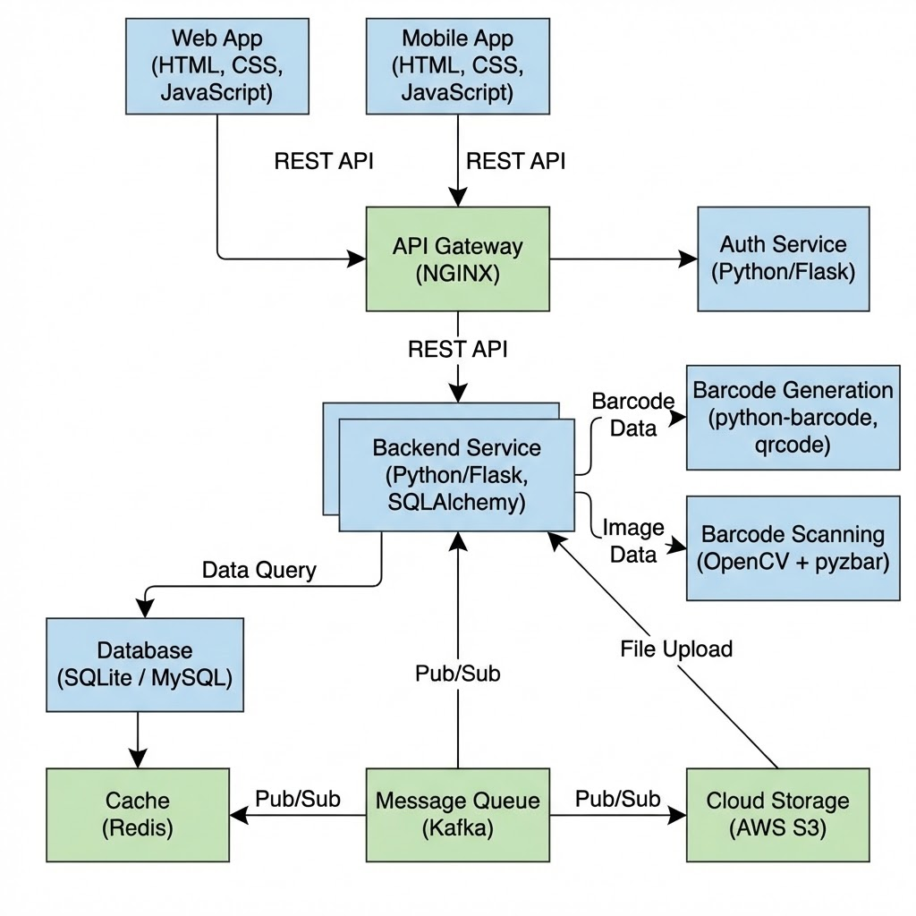
Technical Approach
Technologies Used
Backend: Python (Flask)
Database: SQLite / MySQL
Frontend: HTML, CSS, JavaScript
Barcode Generation: python-barcode, qrcode
Barcode Scanning: OpenCV + pyzbar
ORM: SQLAlchemy
System Workflow
Product added → barcode generated automatically
Barcode scanned via webcam
Product details fetched from database
Stock updated based on buy / sell / return
Changes logged in stock history
Methodology
Modular architecture (Frontend + Backend + Database)
REST APIs for communication
CRUD-based implementation
Incremental feature development

Slide 4
Feasibility and Viability
Feasibility
Uses open-source libraries and tools
Can be developed on a normal laptop
Requires only a webcam for scanning
Simple CRUD-based logic, easy to implement
Viability
Suitable for small retail shops and local businesses
Can be extended for billing, analytics, and reporting
Scalable to multi-user and multi-store environments
Practical for real-world deployment
Challenges & Risks
Camera-based barcode detection issues
Incorrect or duplicate barcode scans
Stock mismatch due to wrong user inputs
Performance issues under poor lighting conditions
Mitigation Strategies
Input validation and quantity checks
Error handling and confirmation prompts
Manual override and correction options
Proper lighting and scan retry mechanisms

Slide 5
Impacts and Benefits
Target Audience
Small shop owners
Retail staff
Inventory managers
Store owners transitioning from manual to digital systems
Social & Economic Benefits
Supports small businesses
Reduces operational costs
Improves efficiency and productivity
Minimizes stock wastage and losses due to mismanagement
Benefits
Time-saving during billing and stock checking
Better stock visibility and control
Efficient handling of returns
Improved organization using category and shelf-based tracking
Impact
Faster product identification
Improved inventory accuracy
Reduced operational errors
Real-time visibility into inventory status

Slide 6
Research and References
Source | Link
Inventory Management – Concepts & Importance | https://www.investopedia.com/terms/i/inventory-management.asp
Barcode Standards and Identification | https://www.gs1.org/standards/barcodes
Barcode-Based Inventory Systems (IEEE) | https://ieeexplore.ieee.org
UN SDG 9 – Industry, Innovation & Infrastructure | https://sdgs.un.org/goals/goal9
UN SDG 12 – Responsible Consumption & Production | https://sdgs.un.org/goals/goal12

